Slide 1

Vehicle Crash Analysis
Kishore Tumarada
Thanh Hung Duong
Team 9 – Kishore Tumarada and Thanh Hung Duong

Slide 2
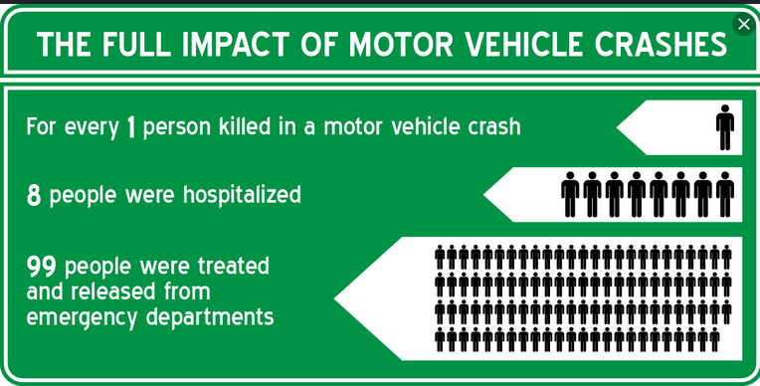
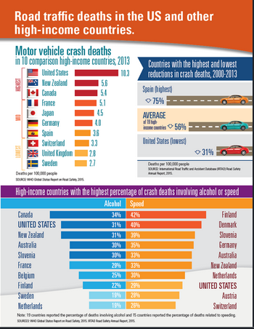
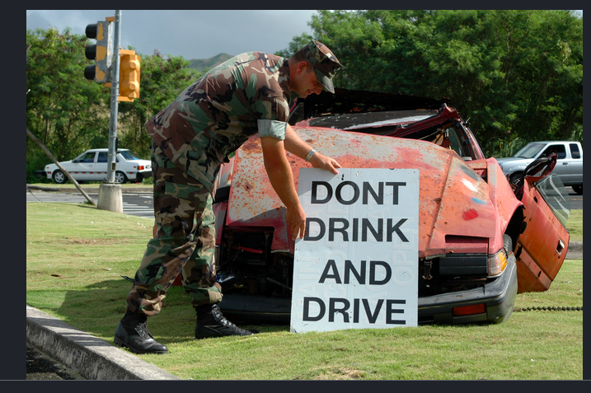
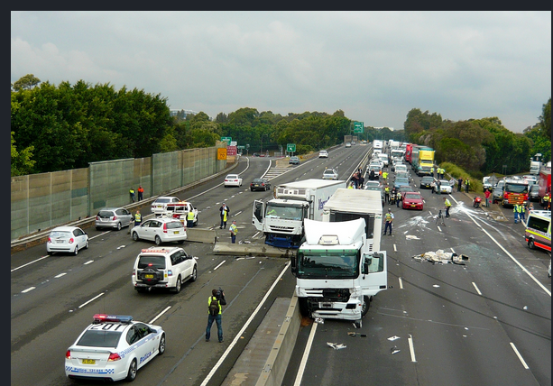
2
Notes:
Average number of car accidents in the .U.S. every year is 6 million.
More than 90 people die in car accidents everyday.
3 million people in the U.S. are injured every year in car accidents.
Around 2 million drivers in car accidents experience permanent injuries every year.

Slide 3
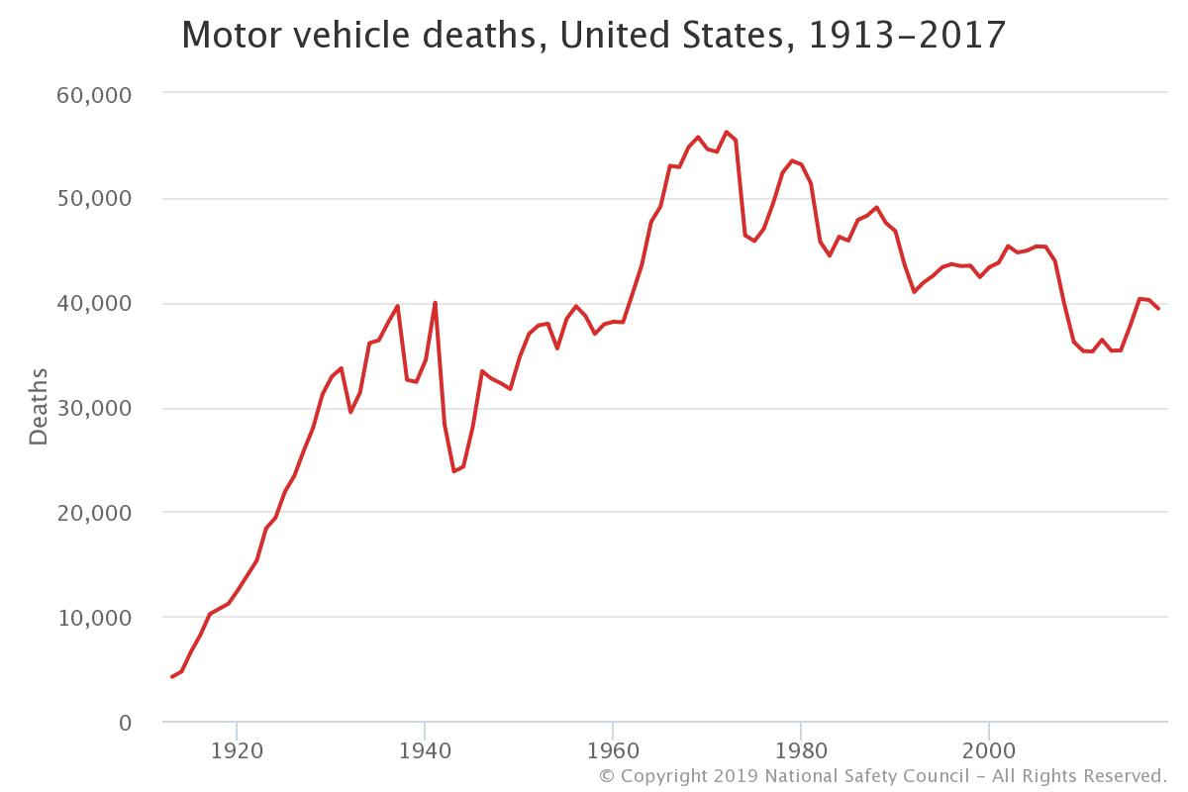
Motivation
People
Vehicle Crash
Economics
Notes:
Average number of car accidents in the .U.S. every year is 6 million.
More than 90 people die in car accidents everyday.
3 million people in the U.S. are injured every year in car accidents.
Around 2 million drivers in car accidents experience permanent injuries every year.

Slide 4

Goals
Overview on vehicle crashes in recent years
State officials can use it to develop traffic strategies
Main interests:
Why vehicle accidents happen?
How severe accidents are?
In what situations, crashes normally occur?
Notes:
We would like to do exploratory data analysis and

Slide 5
Analytical questions
WHY ACCIDENTS
Why high fatalities in some areas
Driver factors - age, previous record, alcoholic/drug
HOW SEVERE
Cost of road crashes
Fatalities inside or outside of vehicle
First harmful/injury- producing event vs most harmful event
Time taken from accident to notification to hospital vs fatalities
WHAT SITUATIONS
Which geographical locations are more accident prone ?
Which type of vehicles are prone
Comparison for accidents and fatalities across time and region
When do accidents happen typically - on a day, in a year
Manner of collision
Pre-crash state of vehicle and attempted maneuver - fatality

Slide 6
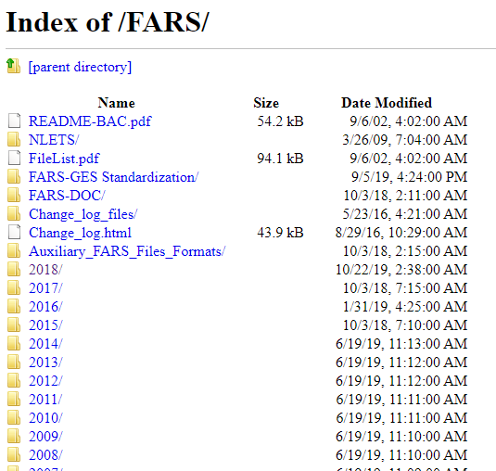
Data sources
National Highway Traffic Safety Administration
ftp://ftp.nhtsa.dot.gov/FARS/
Notes:
Explain attributes and records of the data sources.
Our data source is US National Highway Traffic Safety Administration.
It contains data about every fatal motor vehicle crashes and fatalities across all states of US based on FARS Fatality Analysis Reporting System (FARS).

Slide 7
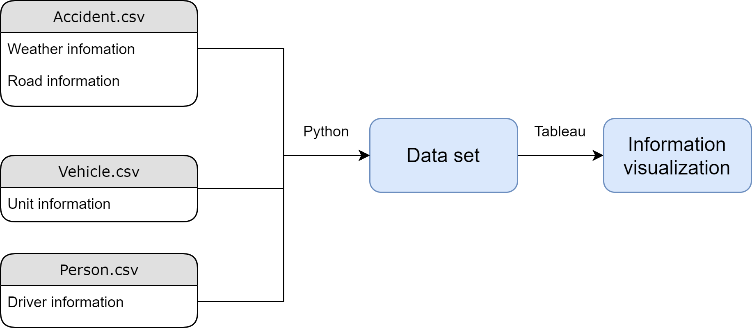
Data preparation
Notes:
We are mainly looking at three datasets – Accident, Vehicle and Person. Accident has features – Location data – lat, long, city, county, state, ; Time ; Type of route;weather
Vehicle – location, car model, kind of impact, fatalities ;
Person – along with age and sex, seating position , drugs or alcohol influence; type of impact
We are planning to join these datasets for a particular location and explore the patterns

Slide 8
Data Preparation
Issues with data
Check for missing values across the datasets
Data related to city name, counties etc are coded in numbers – we have to join tables to replace them with names
Inconsistency in data – number of features and categories of some discrete features have been added in recent years especially after 2014 -
Evaluation of data to select important features such as location of accident, weather, causes of accidents etc
Merging data from different tables – Accident, person, damage
Notes:
Discuss the data structuring process (Issues related to your data sets and how are you planning to resolve them)
Starting from 2014, Pedestrian and Bicyclist files are included in the file release.
Starting from 2018, DRUG related information is stored in DRUG.xxx file instead of in PERSON.xxx file.

Slide 9
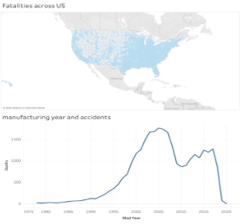
Visual analytics
Which geographical locations are more accident prone in last decade?
Manufacturing year of car and accidents
Comparison of accidents and fatalities
Temporal analysis
Region based analysis

Slide 10
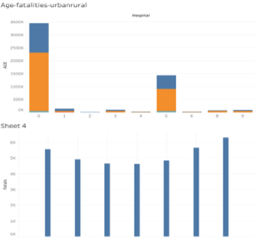
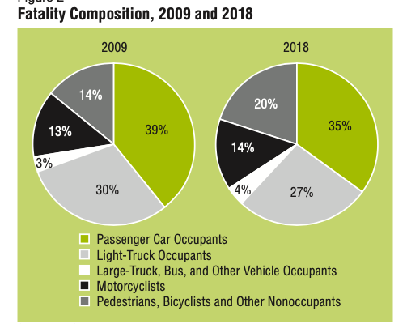
Visual analytics
Notes:
We would like to compare the causes of accidents over the last decade –
for instance the biggest change is in nonoccupant fatalities as a proportion of overall traffic fatalities, increasing from 14 percent to 20 percent from 2009 to 2018.
During this same decade, the percentage of passenger car occupant fatalities decreased from 39 percent of the fatalities to 35 percent.
Explore the relationship between age and urban/rural areas with fatalities.

Slide 11
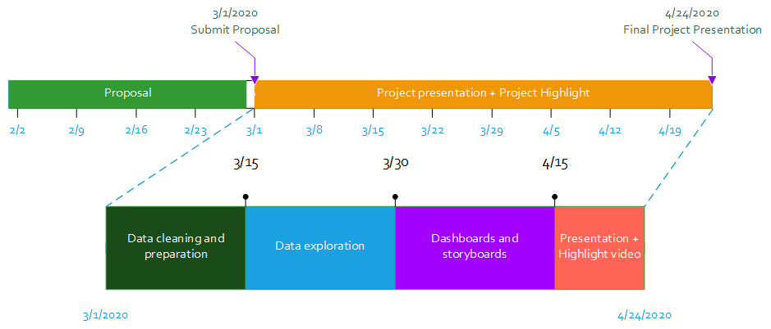
Tentative outline

Slide 12

Thank you

